Slide 1

X-search: Bootstrap paradox
By –
Krishna Bharadwaj
Animesh Patni
Pooja Patel

Slide 2
Introduction
Problem Statement
To improve performance and efficiency of information retrieval on text and metadata
Motivation
To get the know how of how information retrieval works and performing some research on the topic so that we can provide some valuable performance matrix on different search libraries
Related Work
There is lot of research work done on this topic such as EVALUATION OF INFORMATION RETRIEVAL SYSTEMS by Keneilwe Zuva and Tranos Zuva that talks about evaluating information retrieval systems based on precision and recall. However, our emphasis is firmly on query throughput, Index throughput and index size. To put this in simple terms, we look at how fast a search can be performed

Slide 3
TEST BEDS AND SOFTWARE ENVIRONMENT
Baremetal - System Configurations
RAM – 128 GB
Cores – 48 cores
Model - Intel(R) Xeon(R)
CPU E5-2670 v3 @ 2.30GHz
OS – Ubuntu 16.04
Read throughput – 371 MB/s
Disk – 240 GB
Library Versions
Lucene – 7.1.0
LucenePlusPlus - 3.0.7
Xapian – 1.4.8
Workloads
Text Data – 3GB and 20 GB
Meta Data – approx. 1 GB and 7 GB
Instances Used
Baremetal

Slide 4
WORK DONE – Phase 1
Implemented Lucene and LucenePlusPlus on RAM directory
Used a dataset of 2 GB to run our experiments using multiple threads 1,4,8,16
Used both Standard and Simple Analyzer

Slide 5
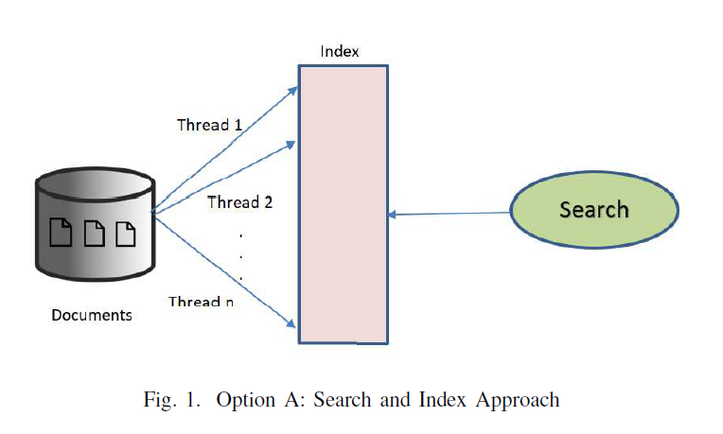
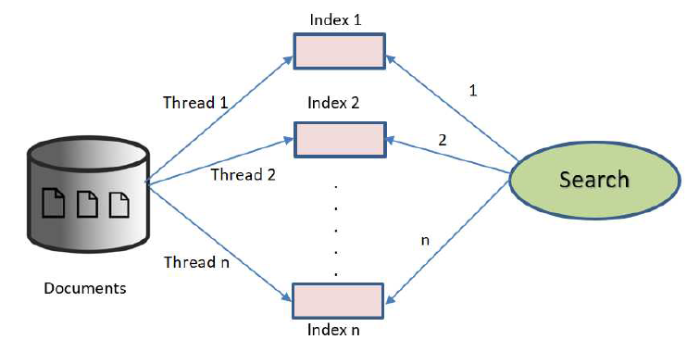
INDEXING APPROACHES
A. Single Index
B. Multiple Index

Slide 6
lucene
Apache Lucene is an open source library, basically used as a full text search engine with bindings to various programming languages
Lucene uses Inverted Index of data which means, instead of mapping pages to keyword, it maps keywords to pages like a glossary at the end of a book
In searching part, once the index is built we search using Lucene classes and the result is a set of retrieved data
Advantage of using Lucene is that the Lucene community is huge and many resources are available for development

Slide 7
lucene
Text Search :
3 GB & 20 GB - implemented using multiple threads like 1,2,4,8,16,32,48
Indexes created on disk for workloads of 3 GB and 20 GB Wikipedia Dumps
Performed experiments on multiple indexers and single global indexer
Calculated index throughput for 3 GB and 20 GB data
Meta Data Search :
Used multi-threading approach for the workload of 1 GB metadata dumps and 7 GB metadata dumps
The number of threads used were 1,2,4,8,16,32,48
Indexes created on Disk for 1 GB and 7 GB workloads
The experiments were performed on both multiple indexer and single global indexer
Calculated index throughput for 1 GB and 7 GB data
The terms that are being searched are essentially a set of 1000 randomly generated words from the workload itself. These words were generated with the help of a python script

Slide 8
lucenePlusplus
LucenePlusPlus is a C++ port of Apache Lucene
Makes use of boost libraries
Makes use of an Inverted Index(Similar to Lucene)
Inherently supports multi-threading and uses almost all the programming constructs similar to Lucene
General lack of documentation proved to be a challenge

Slide 9
lucenePlusplus
Text Search :
Ran experiments on multiple threads from 1,2,4,8,16,32 and 48 threads on 3 GB and 20 GB workloads
Index created on Disk
Ran our first batch of experiment on standard analyser which usually takes the most amount of time as it recognizes URLs and even removes the stop words , lowercases the generated tokens. (Does not index URLs and stop words)
Ran the next batch on Simple Analyzer which consists of LetterTokenizer and a LowerCaseFilter but it doesn’t remove stopwords and also doesn’t recognize URLs. Even tweaked the buffer size to see if the performance changes considerably. (Indexes everthing)
Calculated the index throughput
Meta Data Search :
Ran experiments on multiple threads from 1,2,4,8,16,32 and 48 threads on 1 GB and 7 GB meta data dumps
It was implemented on FSD directory
Calculated the index throughput
The terms that are being searched are essentially a set of 1000 randomly generated words from the workload itself. These words were generated with the help of a python script

Slide 10
XAPIAN
Xapian is an open source library written in C++, which gives the developer a control to add advance indexing and search libraries in there application
The inverted index is apparently implemented as B-Tree with different posting lists broken into chunks and each chunk being indexed by its term and the doc id of the first document of the chunk
Indexes stored in virtual databases on disk
Index Throughput decreased rapidly as the number of files increased
The B-Tree Index proved to be faster than compared to Lucene and LucenePlusPlus
Contacted Xapian developers to get our code verified

Slide 11
XAPIAN
Text Search :
Implemented search using multi-threaded indexing on 1, 2, 4, 8, 16, 32, 48 threads
Index Created on Disk
We implemented this on 3 GBs and 20 GBs of Wikipedia Dumps.
Calculated the index and search latency for 1000 searches
Meta Data Search :
Again all the experiments were performed on multiple threads from 1,2,4,8,16,32 and 48 threads on 1 GB and 7 GB meta data dumps
It was implemented on FSD directory
Index throughput was then calculated
Calculated the index and search latency for 1000 searches
The terms that are being searched are essentially a set of 1000 randomly generated words from the workload itself. These words were generated with the help of a python script

Slide 12
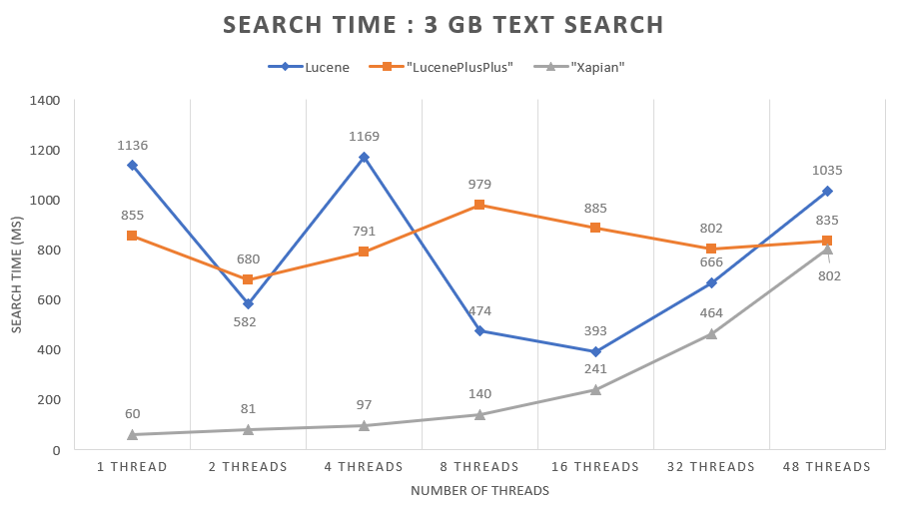
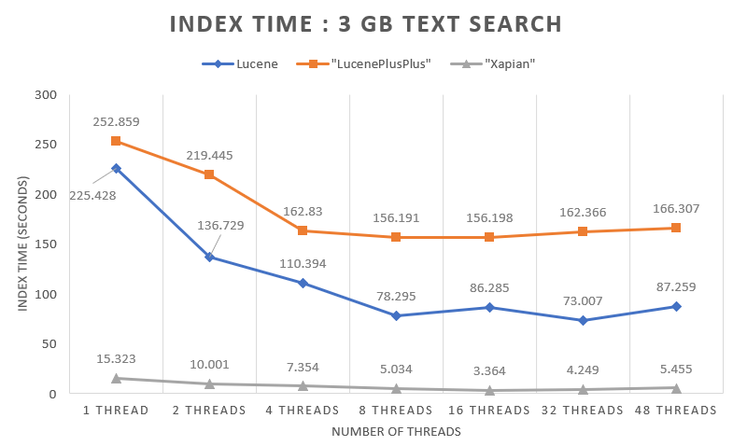
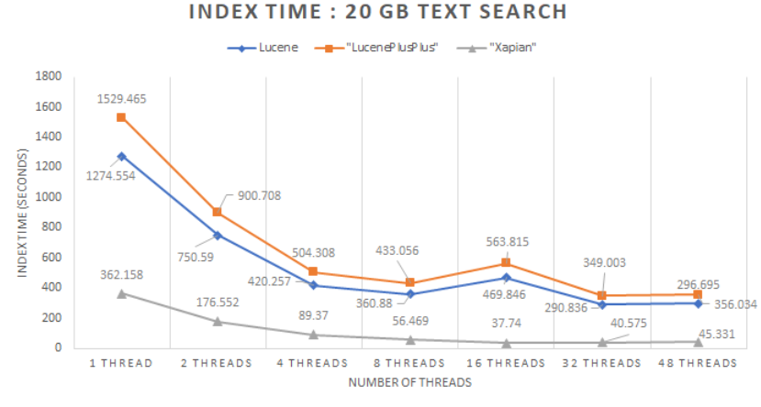
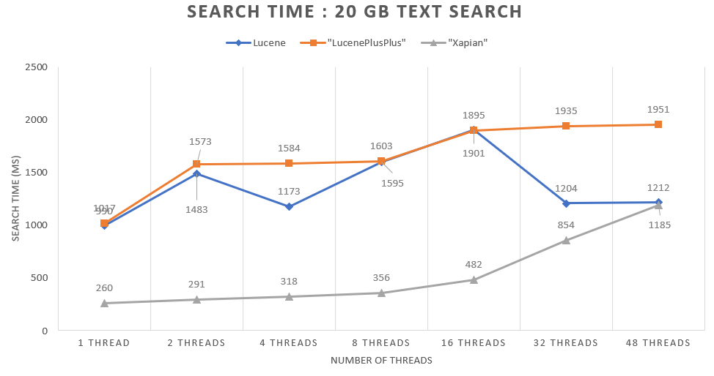
TEXT SEARCH performance evaluation

Slide 13
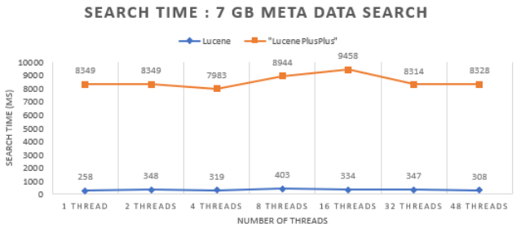
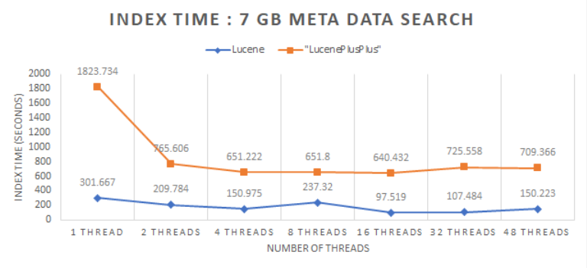
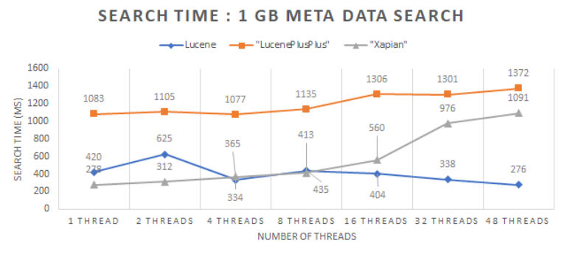
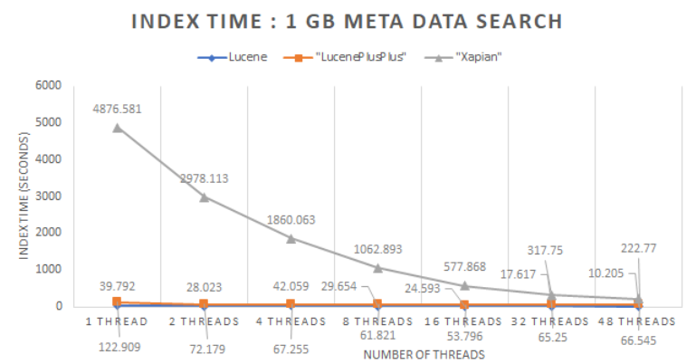
META DATA SEARCH performance evaluation

Slide 14
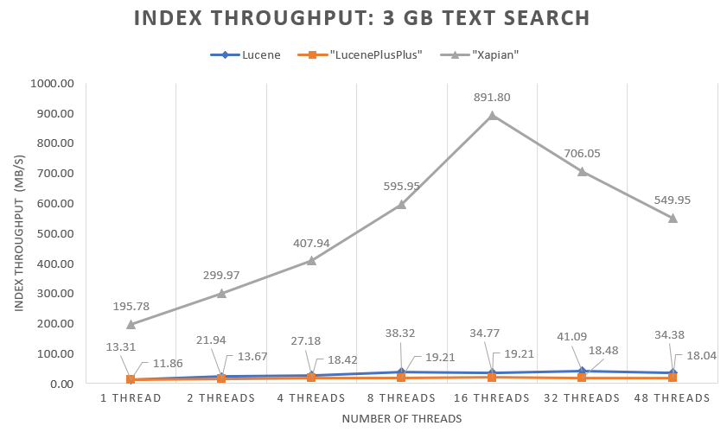
THROUGHPUT performance evaluation – 3 gB TEXT DATA search

Slide 15
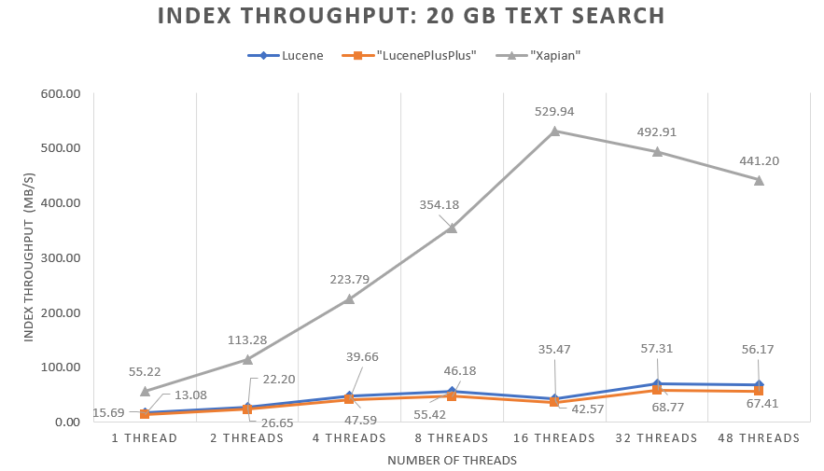
THROUGHPUT performance evaluation – 20 gB TEXT DATA search

Slide 16
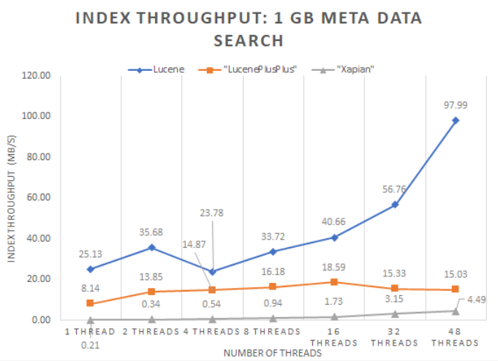
THROUGHPUT performance evaluation – 1 gB meta DATA search

Slide 17
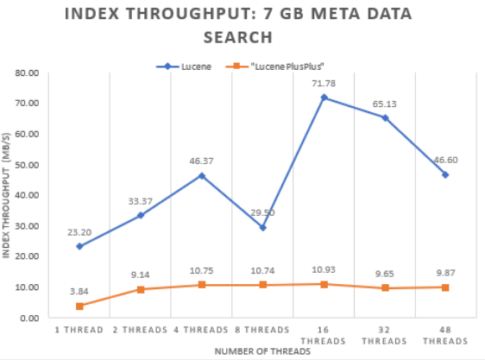
THROUGHPUT performance evaluation – 7 gB meta DATA search

Slide 18
Contribution & future work
Contributions :
All the work related to Xapain and related research was done by Krishna
Lucene experiments and related research by Animesh
LucenePlusPlus experiments and related work by Pooja
However, it was done with each others cooperation and coordination and hence all of has a flavor of the entire project work
Future Work :
Implement Ctrie as a data structure to Index more accurately and efficiently
Support for Ranged Queries in metadata search
Implement these libraries in a distributed environment

Slide 19
references
Alexandru Iulian Orhean, Kyle Chard, Ioan Raicu.“XSearch: Distributed Information Retrieval in Large-Scale Storage Systems”
http://lucene.apache.org/
https://github.com/luceneplusplus/
https://xapian.org/
https://xapian.org/docs/apidoc/html/namespaceXapian.html

